Slide 1




Statistical Portrait of Youth in the Commonwealth of Independent States: situation, problems, perspectives
I.Zbarskaya, CIS-Stat
Working Meeting of Specialists of National Statistical Offices of CIS Member-States
on Youth and Gender Statistics
December 6-7 , 2016, Moscow

Slide 2


Joint initiative of the United Nations Population Fund (UNFPA) and the Interstate Statistical Committee of the Commonwealth of Independent States (CIS-Stat)
Youth in the Commonwealth of Independent States - the first edition of 2014
Youth in the Commonwealth of Independent States - the second edition of 2016
Various aspects of young people’s (15-29 years) lives: their demographic profile, migration, education, employment and quality of life, participation in political life

Slide 3
We express our gratitude for the assistance and information, as well as for critical, but very friendly comments and suggestions
to the experts of CIS National Statistical Offices
staff of the UNFPA Eastern Europe and Central Asia Regional Office; UNECE

Slide 4
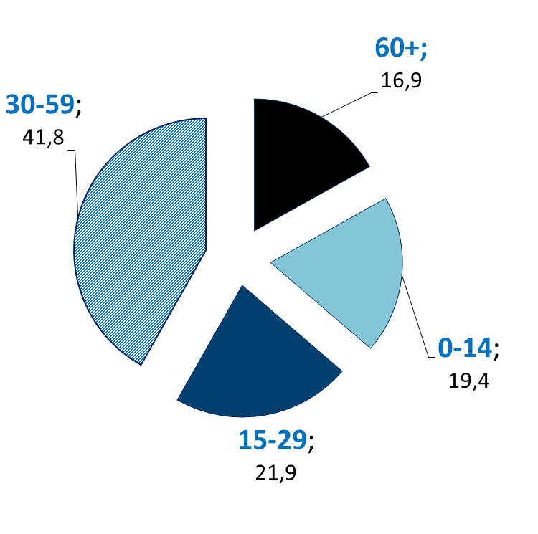
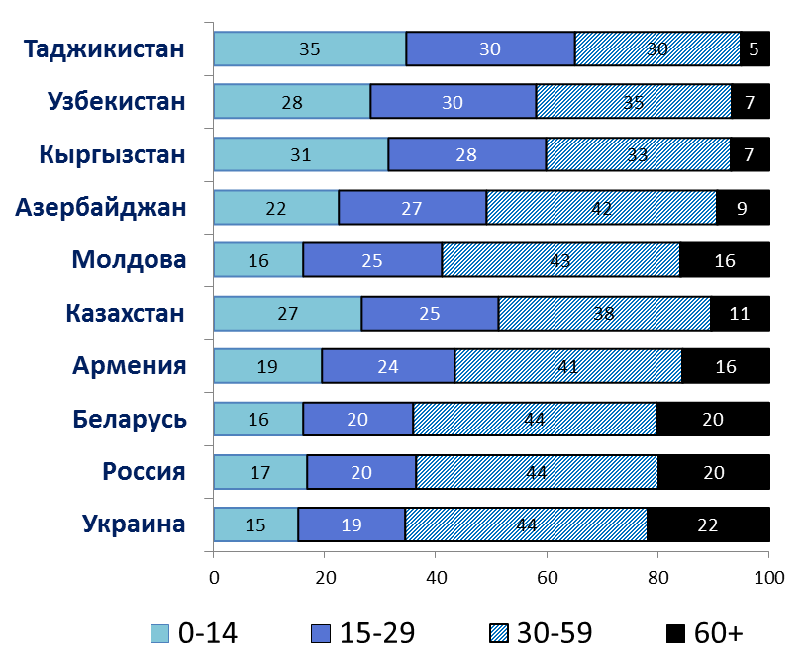
Demographic characteristics (1)
More than 60 million young people aged 15-29 years live in the Commonwealth of Independent States that is one-fifth of the total population
NUMBER OF YOUTH BY AGE GROUP
(percent of total population, 2014)
CIS

Slide 5
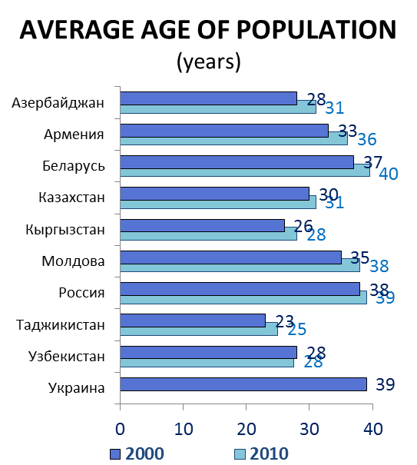
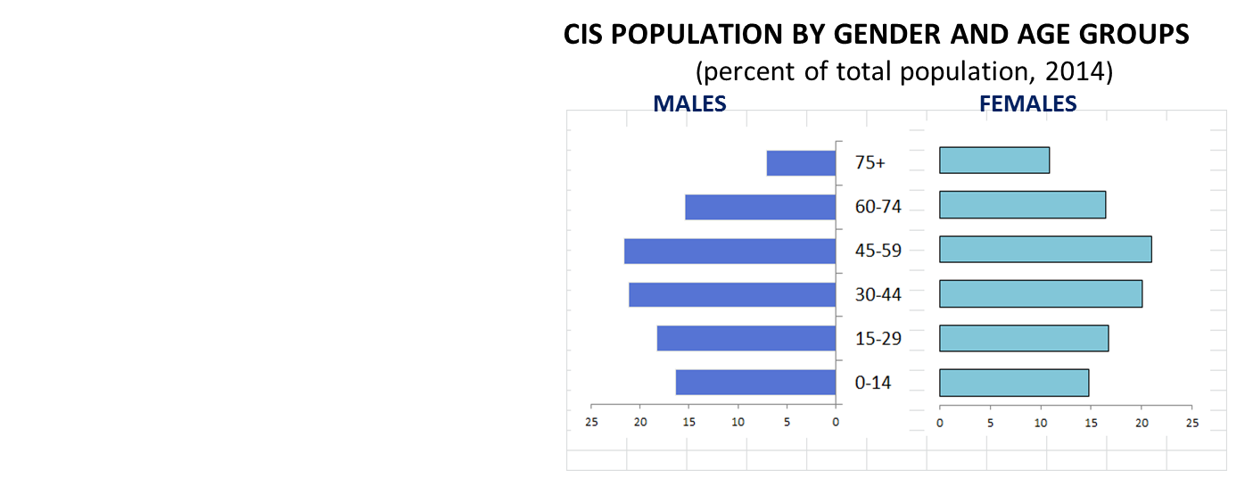
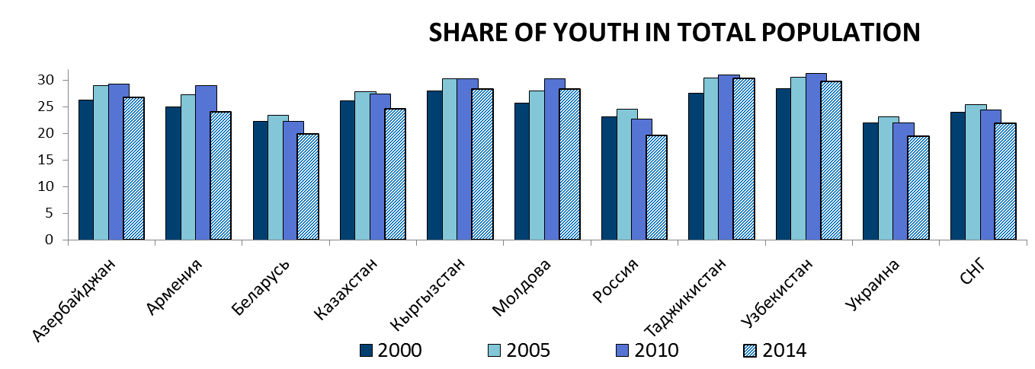
Demographic characteristics (2)

Slide 6
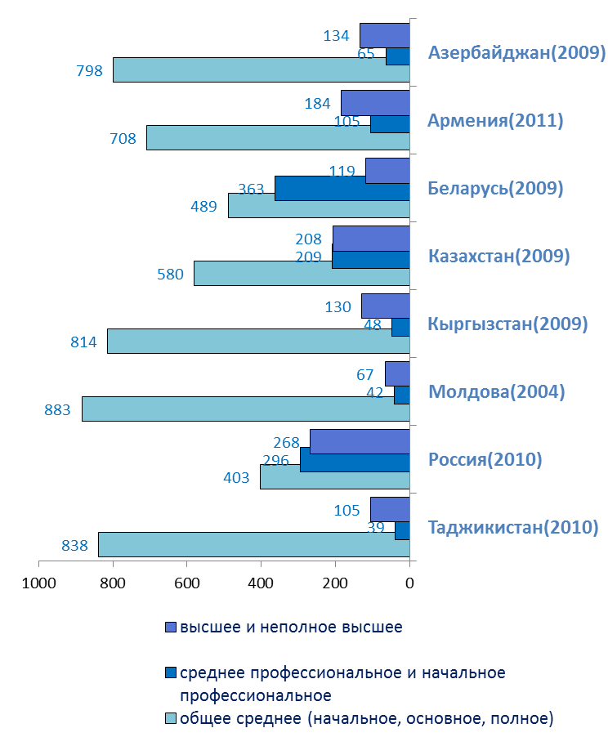
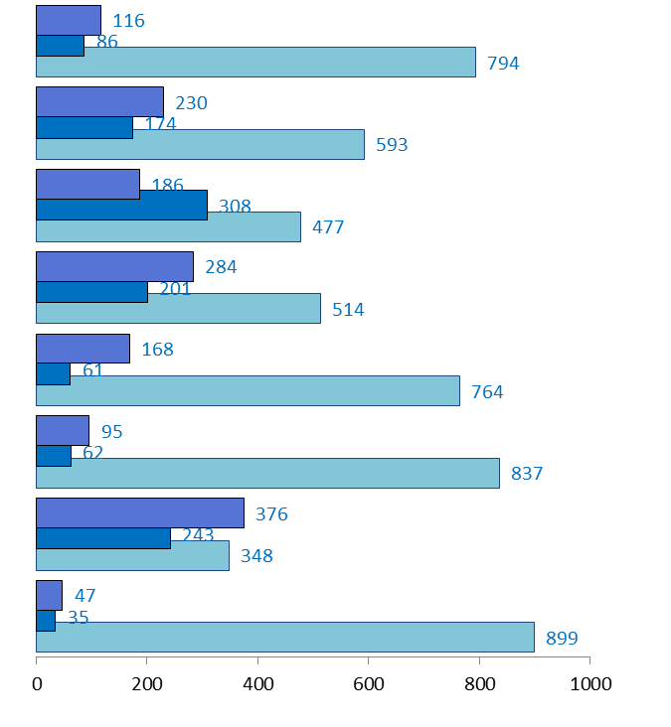
Youth education (1)
LEVEL OF EDUCATION OF POPULATION AGED 15-29
(by Census data; per 1000 population at corresponding age)

Slide 7
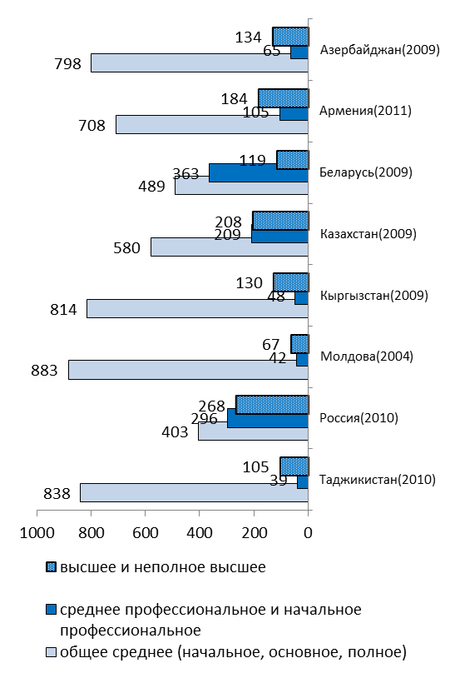
Youth education (2)
GENDER PARITY INDEX IN EDUCATION ¹⁾
 | Ratio of the number of students by gender
 | Daytime general education schools (the upper grades 10-11(12)) | Institutions of initial vocational education | Institutions of secondary professional education | Institutions of higher education
Azerbaijan | 0,82 | 0,37 | 2,07 | 0,94
Armenia | 1,07 | 0,34 | 1,20 | 1,19
Belarus | 1,21 | 0,48 | 1,01 | 1,34
Kazakhstan | 1,17 | - | 0,93 | 1,33
Kyrgyzstan | 1,14 | 0,42 | 1,30 | 1,21
Moldova | 1,33 | 0,45 | 1,12 | 1,35
Russia | 1,21 | 0,45 | 0,98 | 1,17
Tajikistan | 0,84 | 0,29 | 1,60 | 0,46
Uzbekistan | 1,07 | - | 0,96 | 0,60
Ukraine | 1,09 | 0,61 | 1,35 | 1,05
In accordance with the definition of UNESCO the male and female ratio equal to 1 means gender equality; from 0 to 1 – male domination; over 1 – female domination.
.

Slide 8
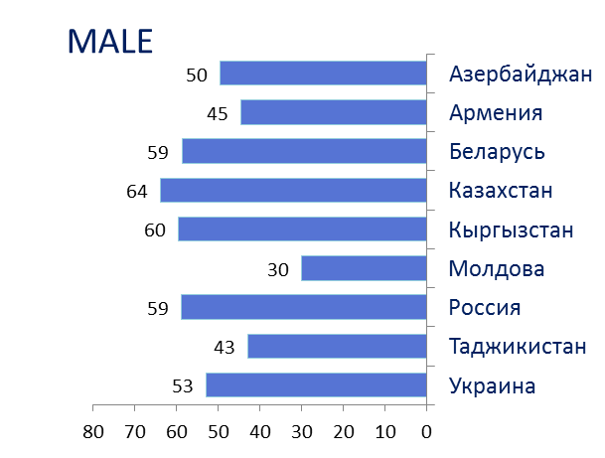
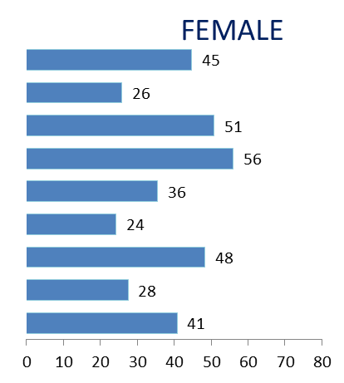
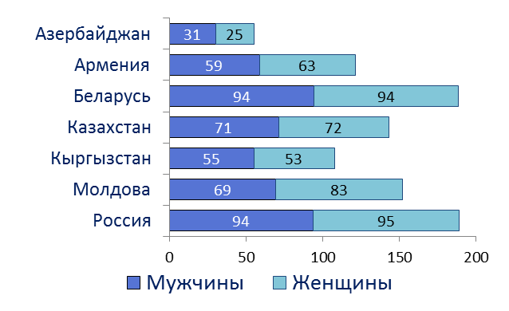
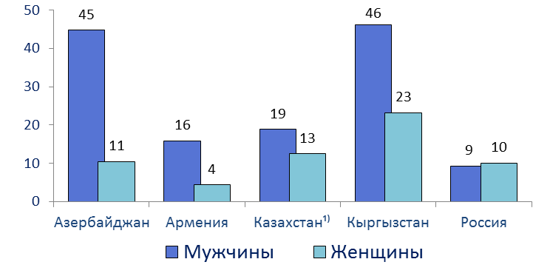
Youth labor market (1)
LEVEL OF YOUTH EMPLOYMENT
(by data of the Labour Force Sample Survey, 2014; percent)
HIRED YOUNG EMPLOYEES
YOUTH EMPLOYER IN THE TOTAL NUMBER OF EMPLOYERS, %

Slide 9
Youth labor market (2)
MAIN SOURCES OF HOUSEHOLDS’ INCOMES, WITH HEAD AGED UNDER 30
(by data of household sample survey; percent to incomes; 2014)
 | Remuneration of employees | Self-employment and entrepreneurship income ¹⁾ | Incomes from the sale of agricultural products | Social payments
Azerbaijan | 38,4 | 24,2 | 8,7 | 15,7
Armenia | 51,0 | 14,4 | 0,5 | 2,7
Belarus | 73,0²⁾ | - | 0,1 | 13,6
Kazakhstan | 82,3 | 5,9 | 0,7 | 6,8
Kyrgyzstan | 52,6 | 19,5 | 10,3 | 2,8
Moldova | 51,4 | 9,1 | 0,1 | 5,4
Russia³⁾ | 75,4 | 6,1 | 0,1 | 9,8
_________
¹⁾ Excluding agriculture.
²⁾ Including self-employment and entrepreneurship income.
³⁾ By data of the sample survey of population income and participation in social programs.

Slide 10
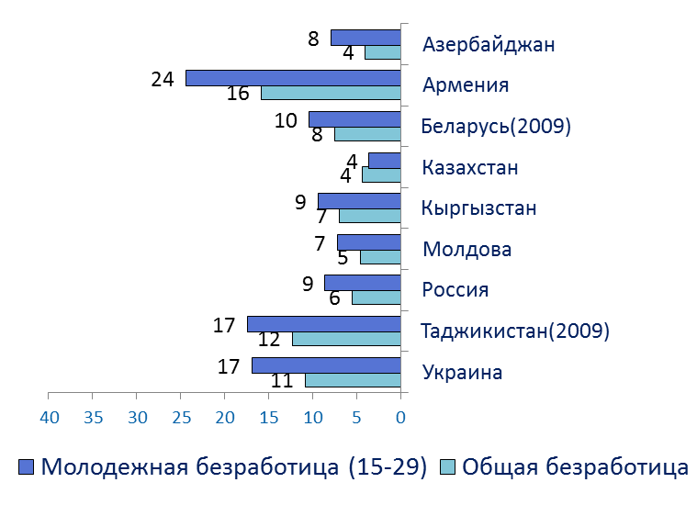
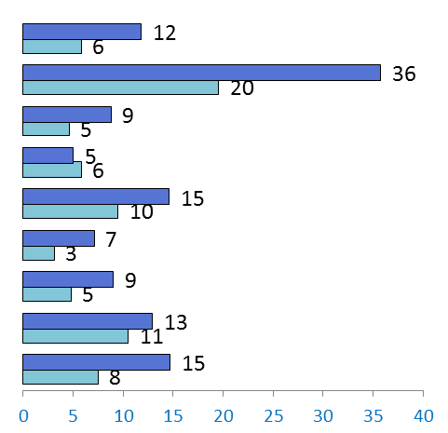
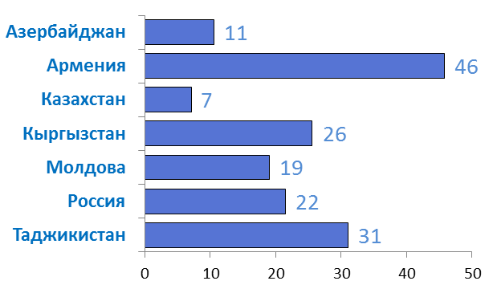
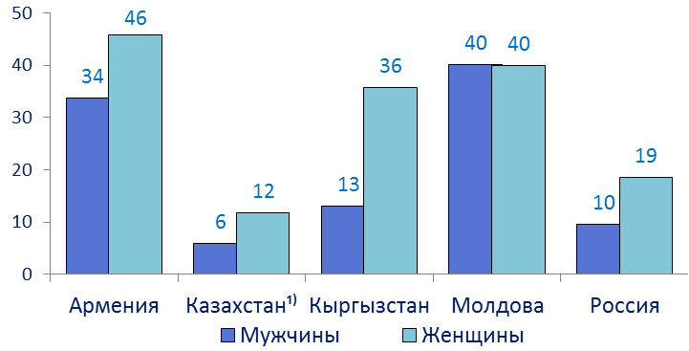
Youth labor market(3)
UNEMPLOYMENT RATES, %
YOUTH SEEKING A JOB FOR 12 MONTHS OR LONGER
(as percentage of all unemployed at the corresponding age)
YOUTH NOT IN EMPLOYMENT, EDUCATION OR TRAINING (NEET)
(as percentage at the corresponding age group)

Slide 11
Youth labor market (4)
UNEMPLOYED POPULATION AGED 15-29 BY LEVEL OF EDUCATION
(by data of the sample Labour Force Survey, 2014; percent)
 | Unemployed population aged 15-29 | including with level of education:
 |  | higher and postgraduate | secondary professional | initial vocational | secondary general | basic general | have no basic general education
Azerbaijan | 100 | 14,1 | 10,6 | 2,2 | 62,2 | 10,8 | 0,1
Armenia | 100 | 38,8 | 13,3 | 2,2 | 43,0 | 2,7 | …
Belarus²⁾ | 100 | 11,9 | 24,1 | 14,9 | 40,0 | 8,4 | 0,5
Kazakhstan¹⁾ | 100 | 41,9 | 29,3 | 4,3 | 22,2 | 2,0 | 0,3
Kyrgyzstan | 100 | 20,5 | 8,5 | 3,1 | 46,2 | 18,7 | 3,0
Moldova | 100 | 28,3 | 8,1 | 21,1 | 18,1 | 24,3 | -
Russia | 100 | 21,1 | 17,6 | 15,9 | 34,2 | 10,2 | 1,1
¹
1) According to the 2009 Population Census.
2) For Kazakhstan - at age of 15-28 (inclusively).

Slide 12
Youth and family (1)
MEAN AGE AT FIRST MARRIAGE AND AT FIRST CHILDBEARING
(number of years)
 | Mean age at first marriage |  |  |  | Mean age of mother at first birth
 | male |  | female
 | 2000 | 2014 | 2000 | 2014 | 2000 | 2014
Azerbaijan | 27,3 | 27,6 | 23,1 | 23,7 | 24,1 | 23,2
Armenia | 27,1 | 29,4 | 23,0 | 26,3 | 22,3 | 24,3
Belarus | 25,0 | 27,4 | 22,8 | 25,3 | 23,3 | 25,7
Kazakhstan | 25,6 | 26,6 | 22,9 | 24,1 | 23,6 | 24,9
Kyrgyzstan | 25,5 | 26,7 | 22,1 | 23,4 | 22,7 | 23,2
Moldova | 25,3 | 27,4 | 22,2 | 24,7 | 22,7 | 24,0
Tajikistan | 24,7 | 25,9 | 21,6 | 22,3 | 21,1 | 22,9
Uzbekistan | 24,2 | 25,8 | 21,4 | 22,5 | 23,2 | 23,4
Ukraine | 25,3 | 27,4 | 22,5 | 24,9 | 24,5 | 27,2

Slide 13
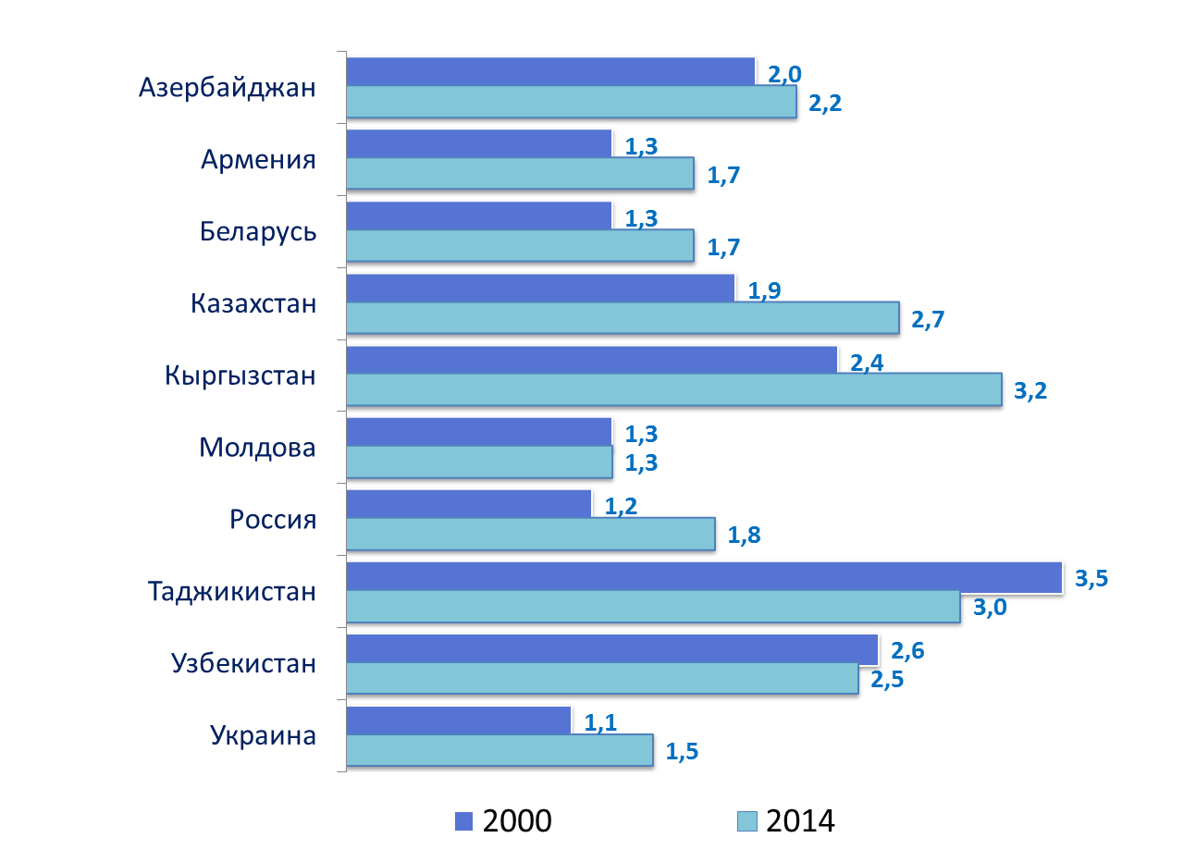
Youth and family (2)
TOTAL FERTILITY RATE

Slide 14
Youth and family (3)
AGE-SPECIFIC FERTILITY RATES
(number of live births per 1000 women at corresponding age)
 | <20 |  | 20-24 |  | 25-29
 | 2000 | 2014 | 2000 | 2014 | 2000 | 2014
Azerbaijan | 29 | 53 | 131 | 169 | 99 | 125
Armenia | 32 | 23 | 120 | 122 | 64 | 102
Belarus | 27 | 21 | 110 | 92 | 76 | 114
Kazakhstan | 33 | 35 | 133 | 162 | 105 | 161
Kyrgyzstan | 34 | 43 | 162 | 201 | 133 | 175
Moldova | 36 | 27 | 104 | 79 | 68 | 76
Россия | 27 | 26 | 94 | 90 | 67 | 110
Tajikistan | 42 | 47 | 208 | 237 | 188 | 168
Uzbekistan | 21 | 24 | 205 | 192 | 161 | 162
Ukraine | 32 | 27 | 95 | 90 | 58 | 91

Slide 15
Youth and family (4)
 | NUMBER OF CHILDREN IN PRESCHOOL INSTITUTIONS
 | as percentage of total children at the corresponding age group |  | per 100 places
 | 2000 | 2014 | 2000 | 2014
Azerbaijan | 15 | 14 | 76 | 89
Armenia | 18 | 29 | 62 | 90
Belarus | 71 | 74 | 86 | 108
Kazakhstan | 10 | 29 | 84 | 109
Kyrgyzstan | 6 | 20 | 86 | 133
Moldova | 36 | 84¹⁾ | 65 | 86
Россия | 55 | 65²⁾ | 81 | 106²⁾
Tajikistan | 5,5 | 9,6¹⁾ | 77 | 107
Uzbekistan | 18 | 15 | 74 | 88
Ukraine | 40 | 56 | 88 | 120
¹⁾ Coverage of children aged 3-6 years.
²⁾ Including institutions engaged in educational activities for preschool programs and child care.

Slide 16
Youth and family (5)
MAIN SOURCES OF HOUSEHOLDS’ INCOMES, WITH HEAD AGED UNDER 30
(by data of household sample survey; percent to incomes; 2014)
 | Remuneration of employees | Self-employment and entrepreneurship income¹⁾ | Incomes from the sale of agricultural products | Social payments
Azerbaijan | 38,4 | 24,2 | 8,7 | 15,7
Armenia | 51,0 | 14,4 | 0,5 | 2,7
Belarus | 73,0²⁾ | - | 0,1 | 13,6
Kazakhstan | 82,3 | 5,9 | 0,7 | 6,8
Kyrgyzstan | 52,6 | 19,5 | 10,3 | 2,8
Moldova | 51,4 | 9,1 | 0,1 | 5,4
Russia³⁾ | 75,4 | 6,1 | 0,1 | 9,8
_________
¹⁾ Excluding agriculture.
²⁾ Including self-employment and entrepreneurship income
³⁾ By data of the sample survey of population income and participation in social programs.

Slide 17
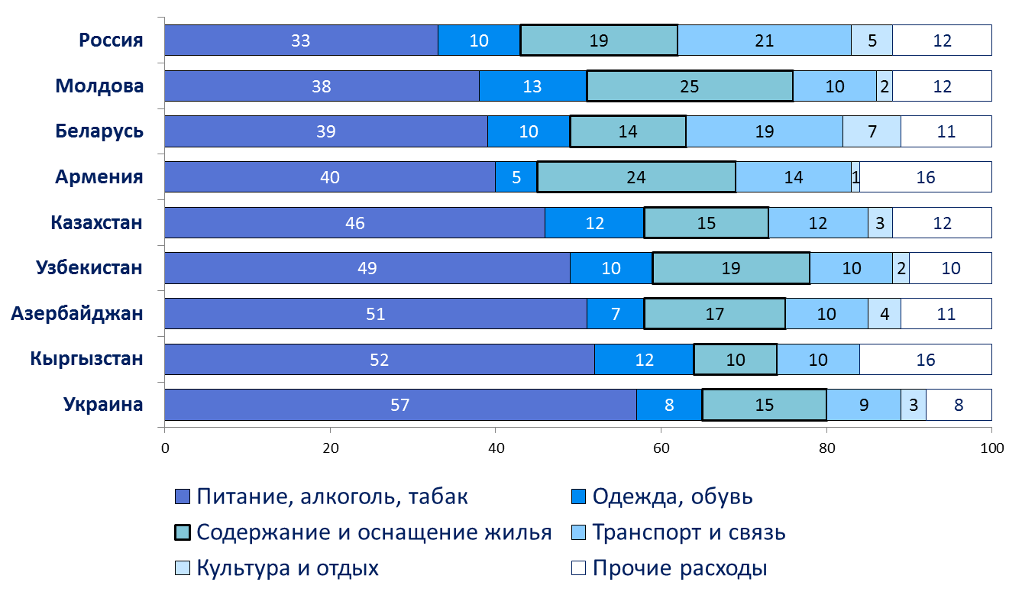
Youth and family (6)
EXPENDITURES OF HOUSEHOLDS WITH HEAD AGED UNDER 30
(by data of household sample survey; percent to consumption expenditures)

Slide 18
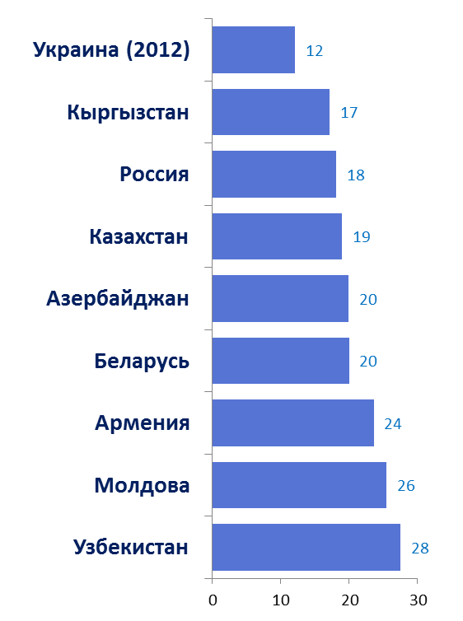
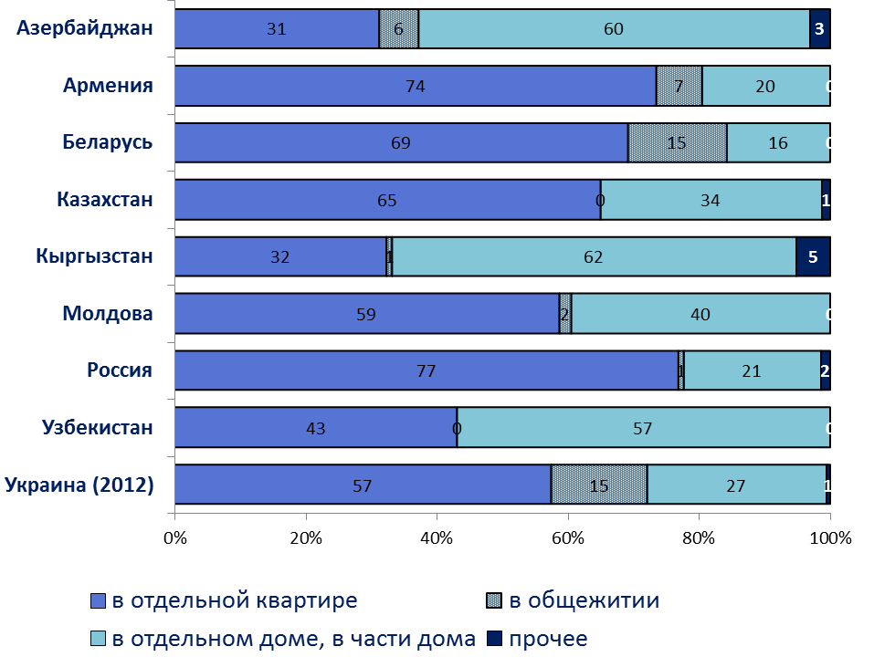
Youth and family (7)
TOTAL DWELLING AREA
(Average per resident, m2, 2014)
DISTRIBUTION OF HOUSEHOLDS WITH HEAD AGED UNDER 30 BY TYPES OF OCCUPIED DWELLING
(by data of household sample survey; percent; 2014)

Slide 19
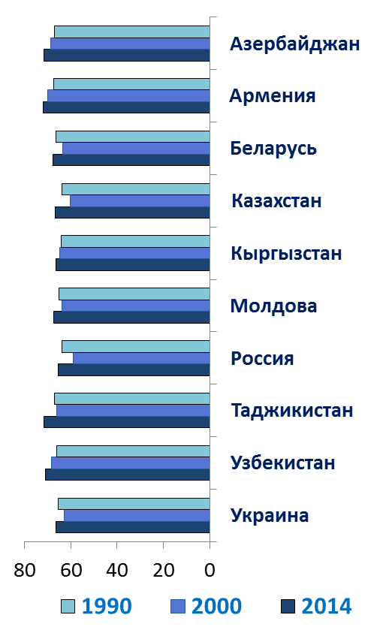
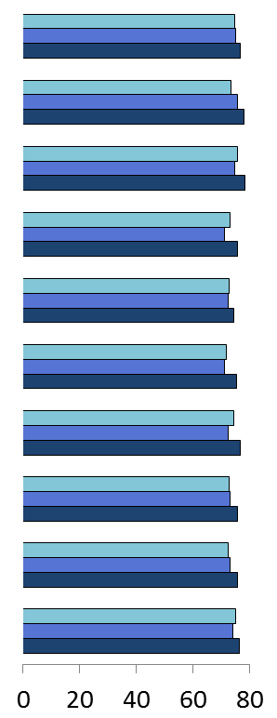
Youth health (1)
LIFE EXPECTANCY
(number of years)
Male
Female

Slide 20
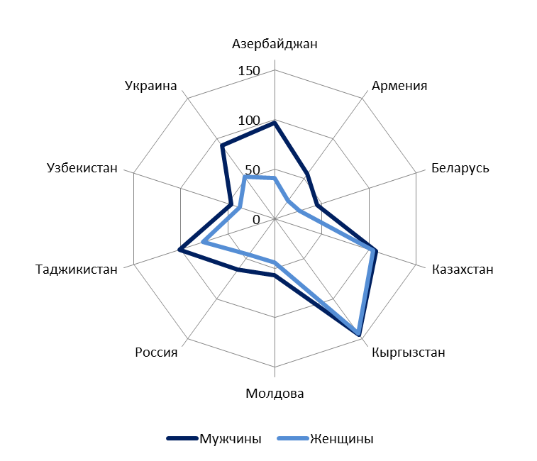
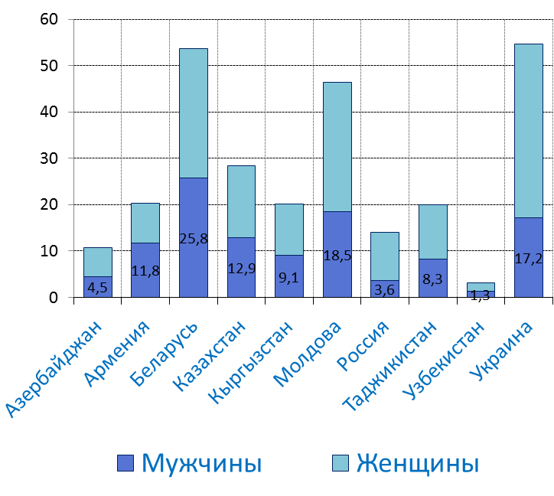
Youth health (2)
TUBERCULOSIS INCIDENCE
(age 15-29; per 100 000 population at corresponding age and gender; 2014)
HIV INCIDENCE AMONG POPULATION¹⁾
(newly diagnosed patients aged 15-29; per 100 000 population at corresponding age and gender; 2014)
___________
¹⁾ Russia and Uzbekistan -15-17 years.

Slide 21
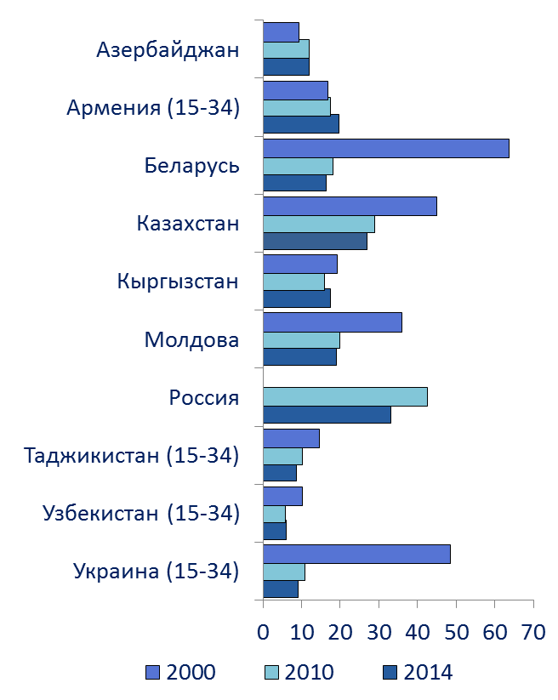
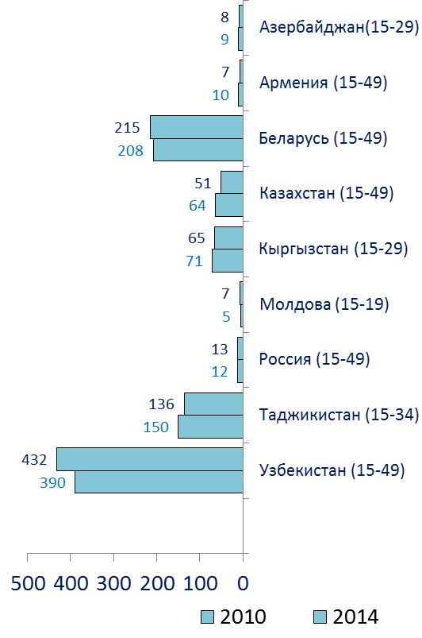
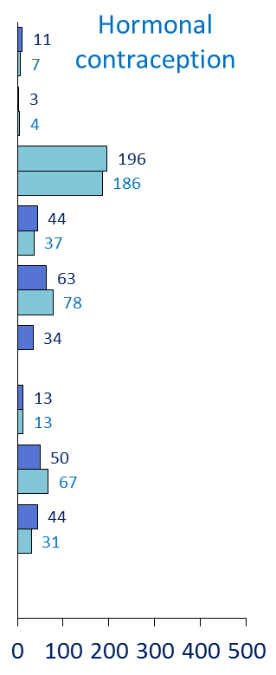
Youth health (3)
ABORTIONS
(at age of 15-29; per 1000 women at corresponding age)
CONTRACEPTIVE PREVALENCE
(per 1000 women at corresponding age)
IUDs

Slide 22
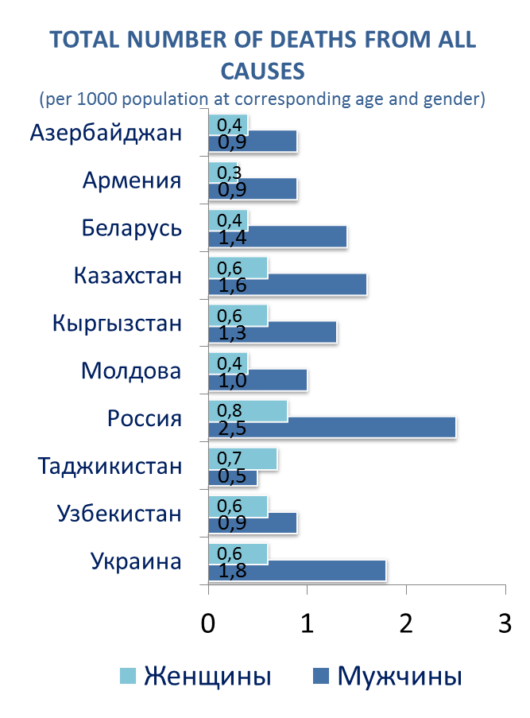
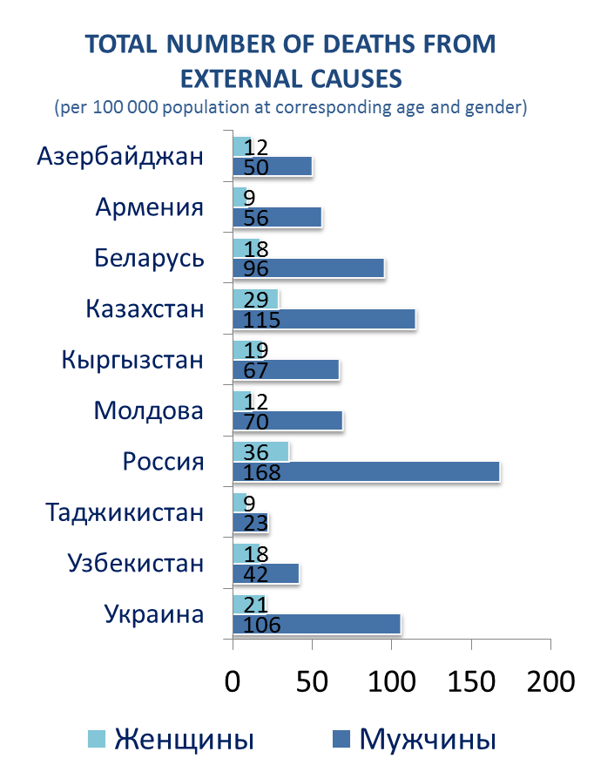
Youth health (4)
MORTALITY OF POPULATION AGED 15-29 IN 2014

Slide 23
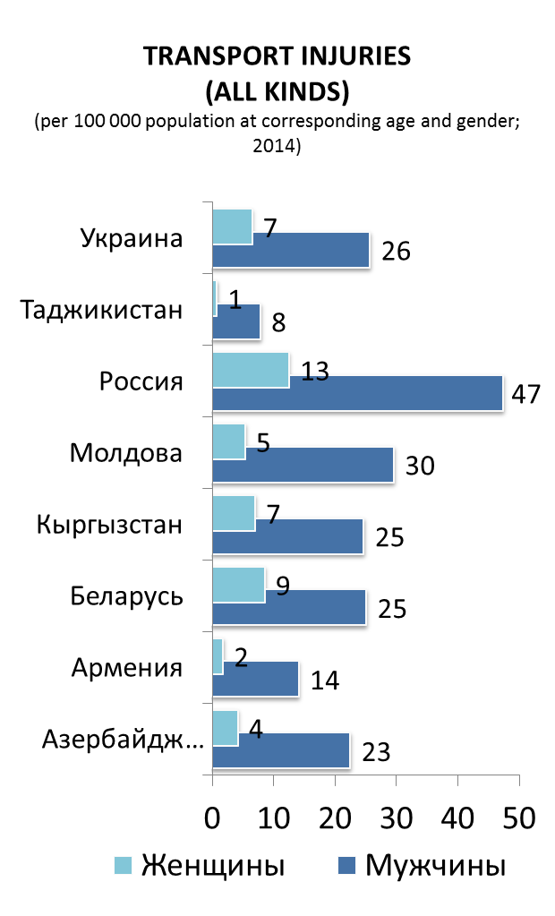
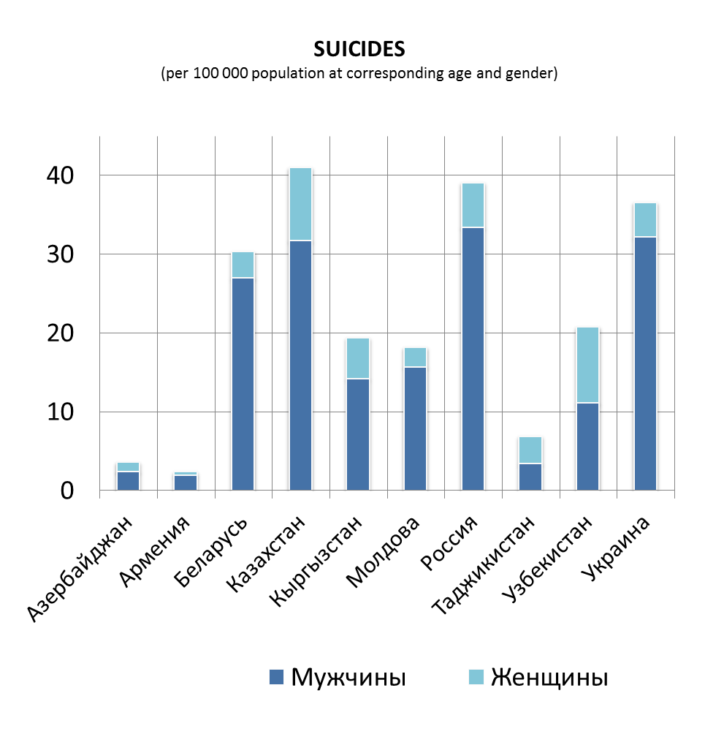
Youth health (5)

Slide 24
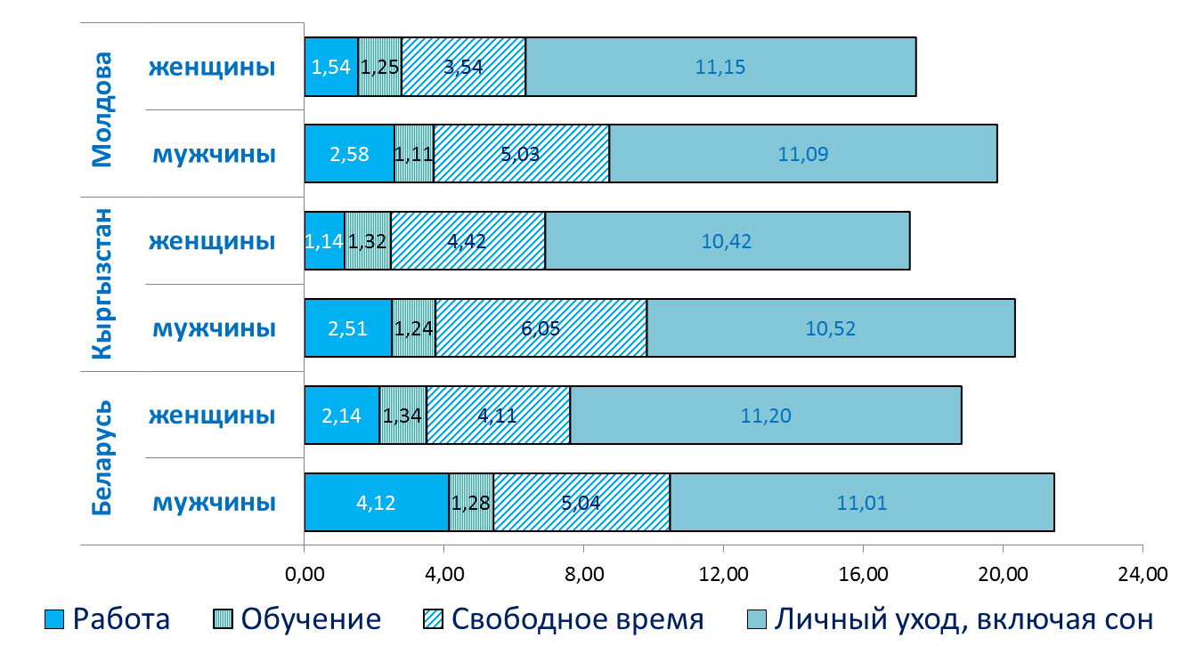
Youth and Society (1)
TIME BUDGET
(hours-minutes a day)

Slide 25
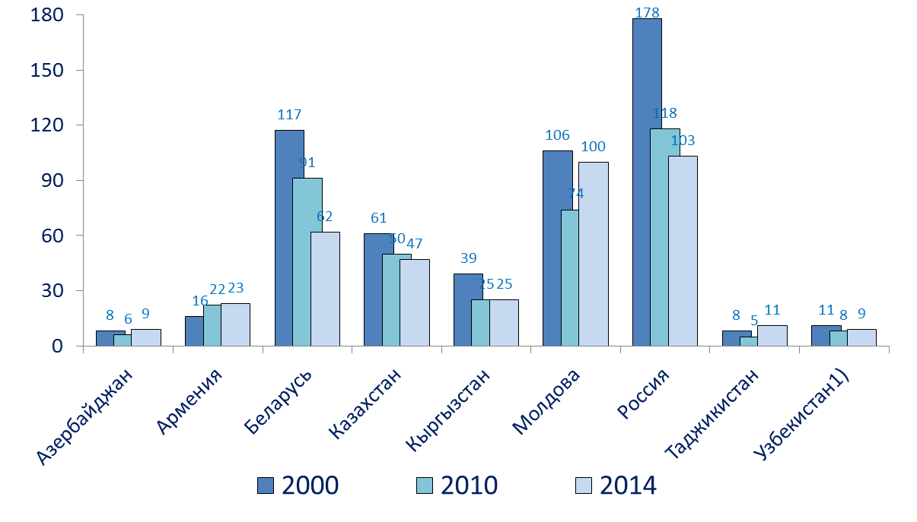
Youth and Society (2)
NUMBER OF ADOLESCENTS AGED COMMITTED CRIMES
(aged 14-17; per 10000 adolescents at corresponding age)

Slide 26
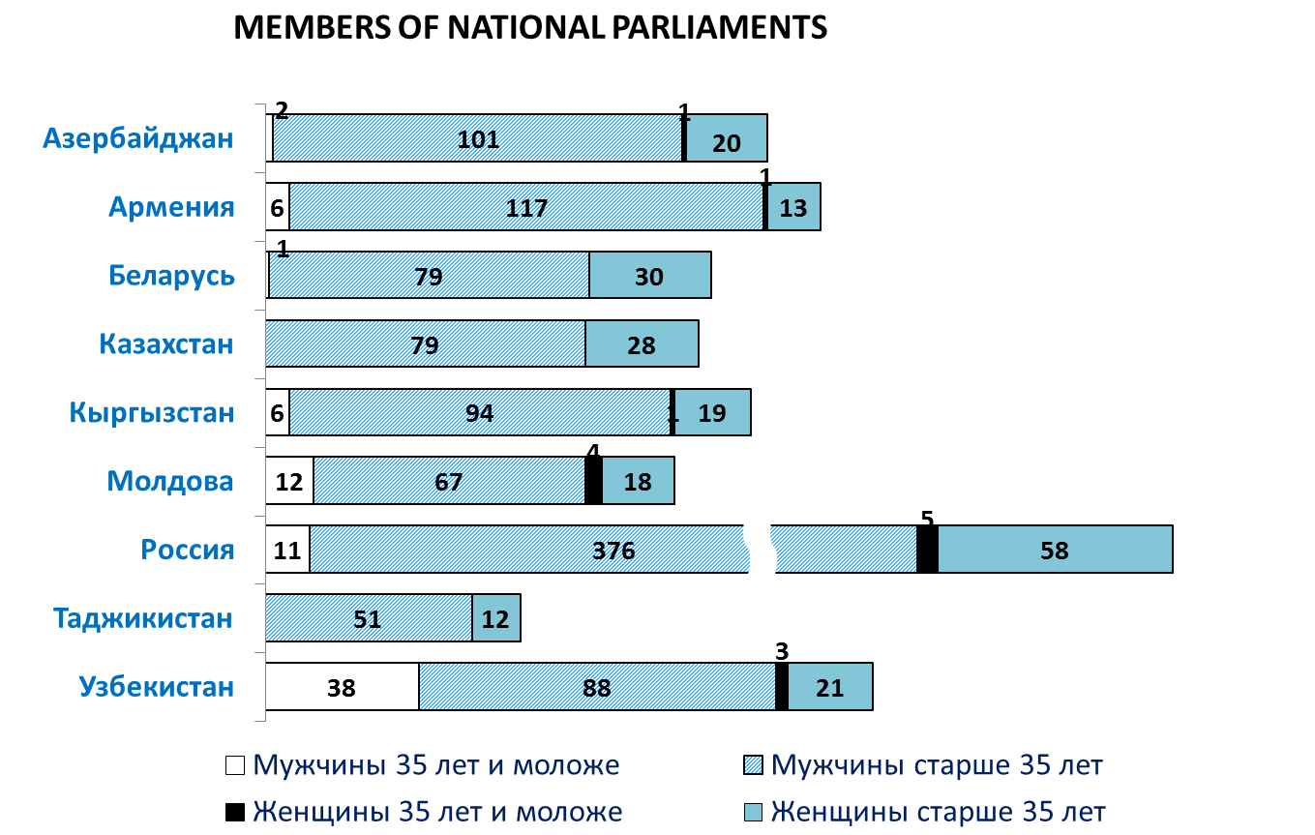
Youth and Society (3)

Slide 27
The share of youth aged 15-29 in the CIS countries ranges from 21% in Belarus, Russia, and Ukraine to 31% in Tajikistan and Uzbekistan.
Problems of information support :
The lack of official statistical information that characterizes many aspects of youth activities – standards of living, leisure, health, involvement in social life;
The lack of information in the context of gender in many socio-economic indicators.

Slide 28
Youth in the Commonwealth of Independent States:
a Statistical Portrait
THANK YOU!

